Slide 1

Instagram Post Likes Prediction
Leveraging Machine Learning to forecast the popularity of the Instagram posts - Shihao Wang

Slide 2


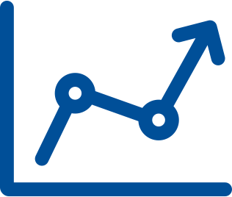
Introduction
ANALYZING INSTAGRAM POSTS DATA
PREDICTING POST PERFORMANCE
OPTIMIZING CONTENT STRATEGY
Investigating the dataset through exploratory data analysis reveals insightful patterns and relationships
Using historical data and content analysis to forecast the engagement potential of future Instagram posts.
Applying insights from the predictive model to refine and enhance an Instagram content strategy.
BY HARNESSING THE POWER OF MACHINE LEARNING, THIS PRESENTATION WILL EXPLORE HOW BUSINESSES AND CREATORS CAN GAIN VALUABLE INSIGHTS TO IMPROVE THEIR INSTAGRAM PERFORMANCE AND ACHIEVE GREATER ENGAGEMENT WITH THEIR AUDIENCE.

Slide 3





Project Workflow
3
FEATURE ENGINEERING
Time-based features calculation: post hour, day of week etc
5
MODEL DEVELOPMENT
Regression Model: XGBRegressor
Engagement features calculation: comment rate etc Image feature extraction with ResNet
1
DATA COLLECTION
Classification Model: XGboost Classifier
Dataset description: 3,785 Instagram posts with various features
6
BUSINESS RECOMMENDATIONS
4
ADVANCED IMAGE ANALYSIS
Analyze the model's performance
2
EXPLORATORY DATA ANALYSIS (EDA)
Image analysis of distinctive qualities that influence engagement
Interpret the results and provide actionable insights and business recommendations
Distribution of key variables
Explored temporal trends in user engagement and posting habits

Slide 4
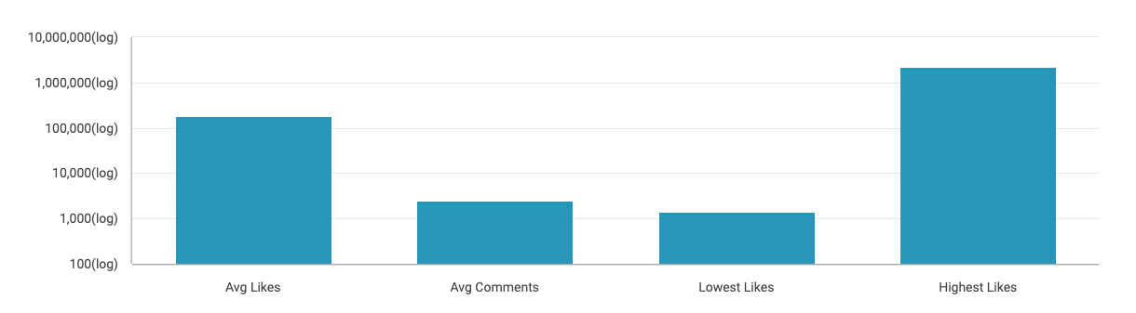
Exploratory Data Analysis: Instagram Post Engagement
THE DATASET SHOWS A WIDE RANGE OF ENGAGEMENT, WITH A LARGE DIFFERENCE BETWEEN THE LOWEST AND HIGHEST NUMBER OF LIKES.
*Instagram post data

Slide 5

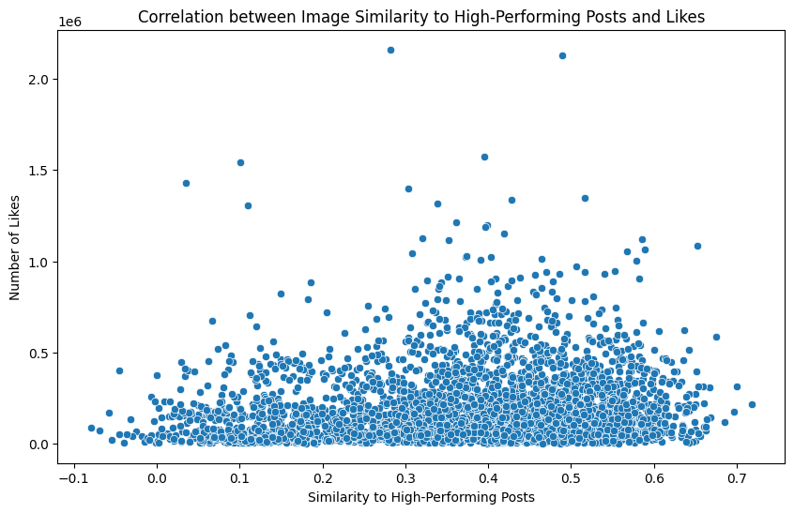
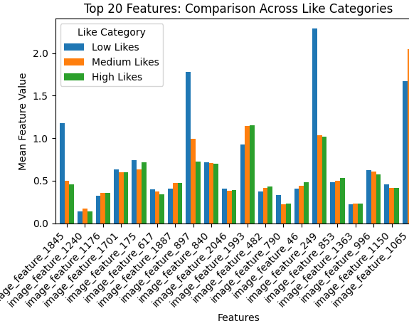
Image Feature Analysis
There appears to be a general positive correlation between similarity to high-performing posts and the number of likes received. As the similarity score increases, there's a tendency for posts to receive more likes.
Feature Variability:Different features show varying patterns across like categories, indicating that certain visual elements are more associated with higher or lower engagement.High-Impact Features:Features like 'image_feature_1845', 'image_feature_897', and 'image_feature_1605' show notable differences across categories, suggesting they strongly influence post popularity.Category-Specific Trends:'image_feature_1845' is significantly higher for Low Likes posts, potentially indicating a visual element to avoid.'image_feature_1605' shows a clear increasing trend from Low to High Likes, suggesting a visual characteristic highly associated with popular posts.
I visualized the top 5 positive and negative impact features and seems like low like posts contain more Text-heavy content: All images contain a significant amount of text, which is typical for ads but less engaging on a visual platform like Instagram. The images often use charts, tables, and infographic-style elements, which are informative but may not be as visually appealing as lifestyle or artistic photos.Corporate/official branding:Logos and official seals are prominent, giving a formal, advertisement-like appearance. The use of bold, solid colors (blue, yellow, green, red) is common in advertising to grab attention, Clear calls-to-action and promotional language are visible, which users might find less engaging than organic content
Aiming for moderate to high similarity with successful posts can generally improve performance, but shouldn't be the only focus.

Slide 6



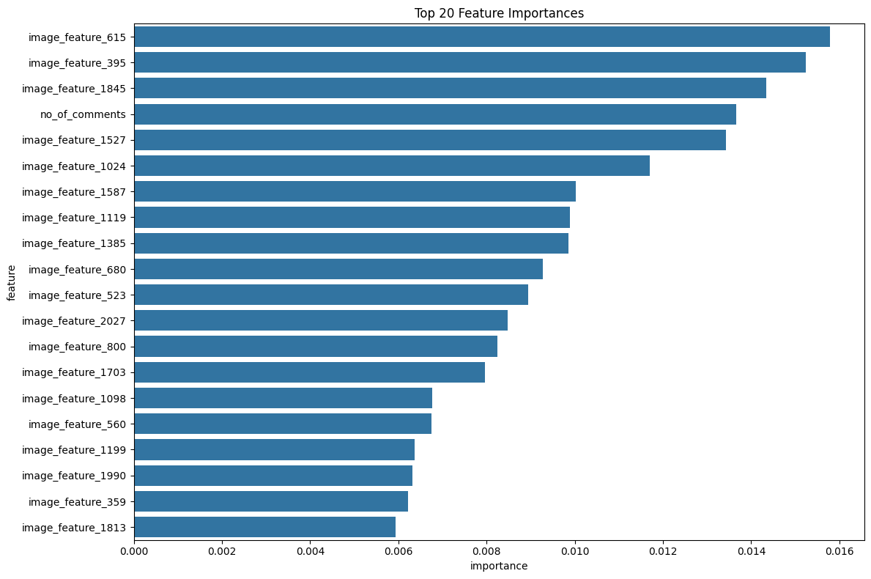
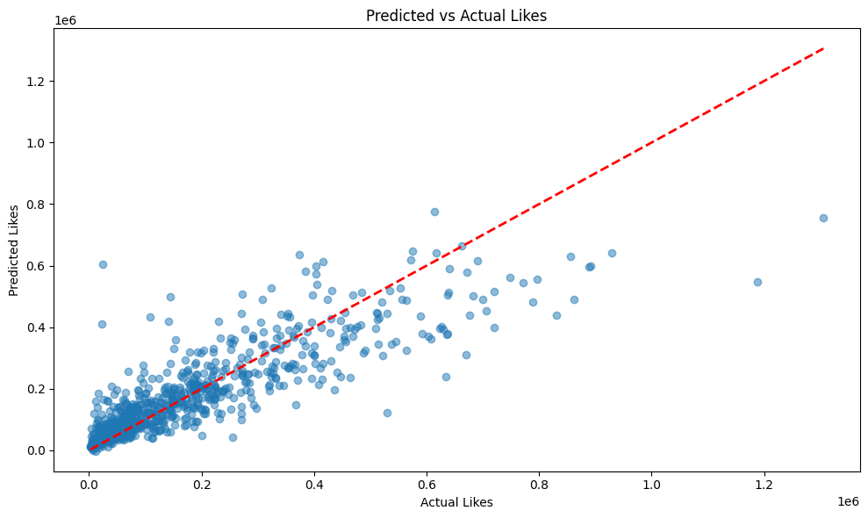

Model 1: XGBRegressor
FEATURES USED
MODEL PERFORMANCE
BEST PARAMETERS FOUND
no_of_comments',
R-squared score of 0.7655,
'follower_count_at_t',
colsample_bytree: 0.8
'post_hour',
learning_rate: 0.1
'is_weekend',
The Root Mean Squared Error (RMSE) is 89,333.97,
max_depth: 3
'is_evening',
n_estimators: 200
'comment_rate',
subsample: 1.0
'is_viral',
'log_follower_count'
'image feature'
FINDINGS
The scatter plot shows predicted vs. actual likes, with the red dashed line representing perfect predictions.
Many points cluster around this line, especially for lower like counts, indicating good prediction accuracy for posts with fewer likes.
There's more scatter and deviation from the perfect prediction line as the number of likes increases, suggesting the model is less accurate for highly popular posts.

Slide 7

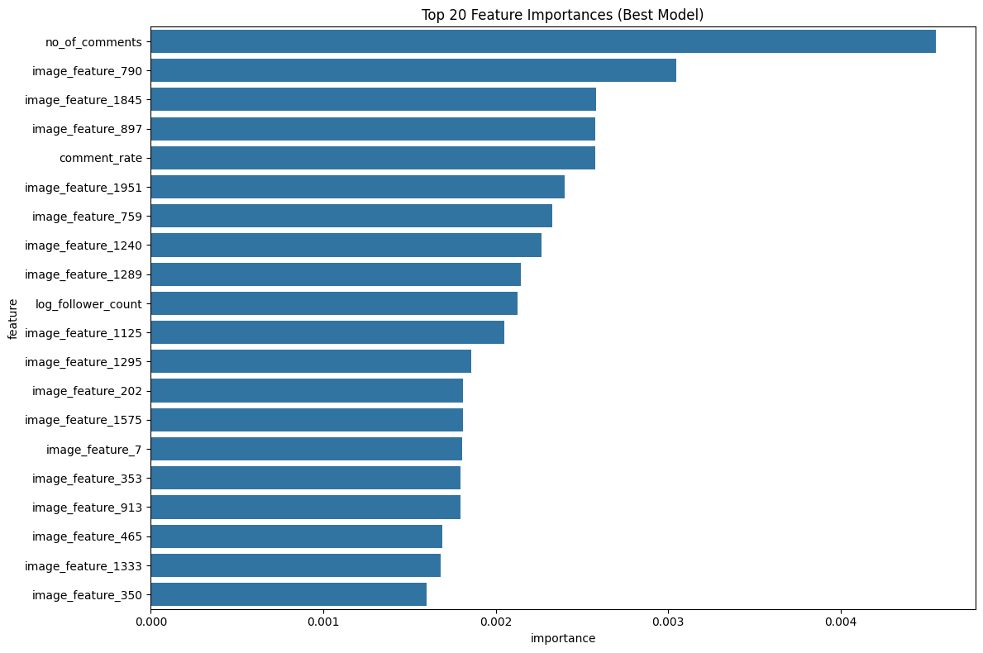
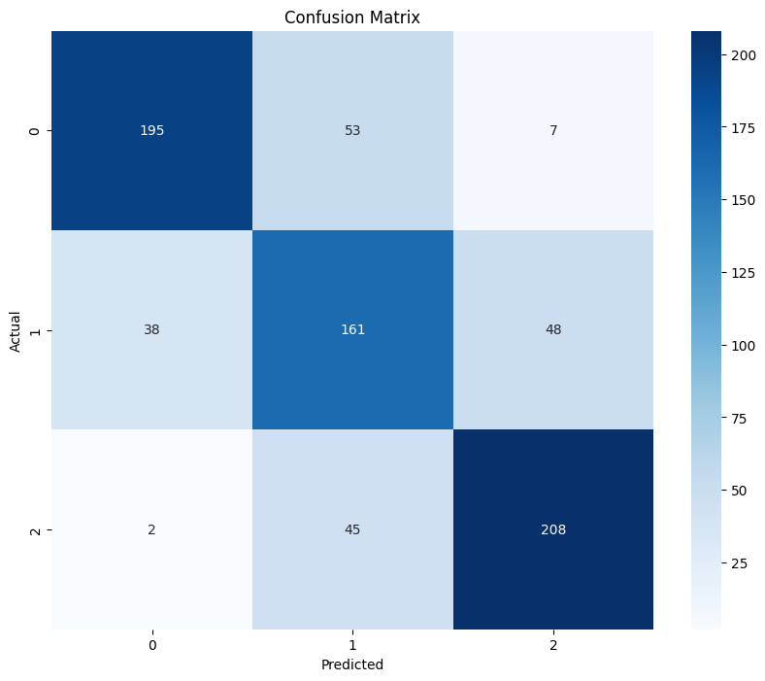
Model 2: XGBoost Classifier
FEATURES USED
MODEL PERFORMANCE
BUSINESS IMPLICATION
no_of_comments',
overall accuracy of 74%, indicating it correctly classified 74% of all instances.
'follower_count_at_t',
The model is particularly good at identifying potentially viral posts (high likes) and posts that might need improvement (low likes).There's some confusion in the middle range, which might require additional features or model tuning to improve differentiation of medium-performing posts.
'post_hour',
'is_weekend',
'is_evening',
'comment_rate',
'is_viral',
'log_follower_count'
'image feature'
FINDINGS
The model performs best on identifying posts with low likes (Class 0) and high likes (Class 2), with F1-scores of 0.79 for both
It struggles more with identifying posts with medium likes (Class 1), with a lower F1-score of 0.63.
The model has a balanced performance across all classes, as indicated by similar macro and weighted averages (both 0.74).

Slide 8




Business Recommendations
PREDICTIVE CONTENT SCORING
AUTOMATED CONTENT CATEGORIZATION:
REAL-TIME MONITORINNG
VISUAL CONTENT OPTIMIZATION
Integrate the models into a real-time dashboard that compares actual post performance against predicted performance. This allows for quick identification of unexpectedly high-performing content for potential boosting or replication. Early detection of underperforming posts, enabling rapid response (e.g., adjusting promotion strategy or timing).
Implement the XGBoost regression model as a content scoring system. Before posting, run potential content through the model to predict its likely engagement level. This allows content creators to prioritize and refine posts predicted to perform well, potentially increasing overall engagement rates.
Utilize the XGBoost classification model to automatically categorize posts into low, medium, and high engagement potential. Inform content scheduling, ensuring a mix of high-potential posts with others. Guide resource allocation, focusing more effort on refining and promoting high-potential content.
Given that text-heavy, infographic-style content tends to perform poorly, recommend a shift towards more visually appealing content. Reduce text overlay on images, keeping it to a minimum Replace charts and tables with more engaging visual representations of data, such as simple icons or illustrations.c) Experiment with lifestyle or artistic photos that subtly incorporate the brand message, rather than relying on corporate logos and official seals.

